Slide 1
Climate Programme/SEAP
Gothenburg
Notes:
Vad är klimatprogrammet, varför har vi det
Långsiktiga målet
Vilka utmaningar har vi, möjligheter, gubben, stadsbilden
Processen, samverkan med många olika aktörer
Hur SEAP:en har blivit förbättrad
Hur Step Up-leverabler har varit användbara för processen

Slide 2
Climate Programme for Gothenburg
“In 2050 Gothenburg has a sustainable and equitable level of greenhouse gas emissions”
Includes our energy plan
Vision and objectives for the city
Strategies where the city can make a difference (directly and indirectly)
Notes:
The Climate Programme defines strategically the 2050 objective
The 2050 objective broken down into strategy objectives within different areas
To the objectives are strategies connected
The strategies can contain different actions, carried out by different stakeholders

Slide 3
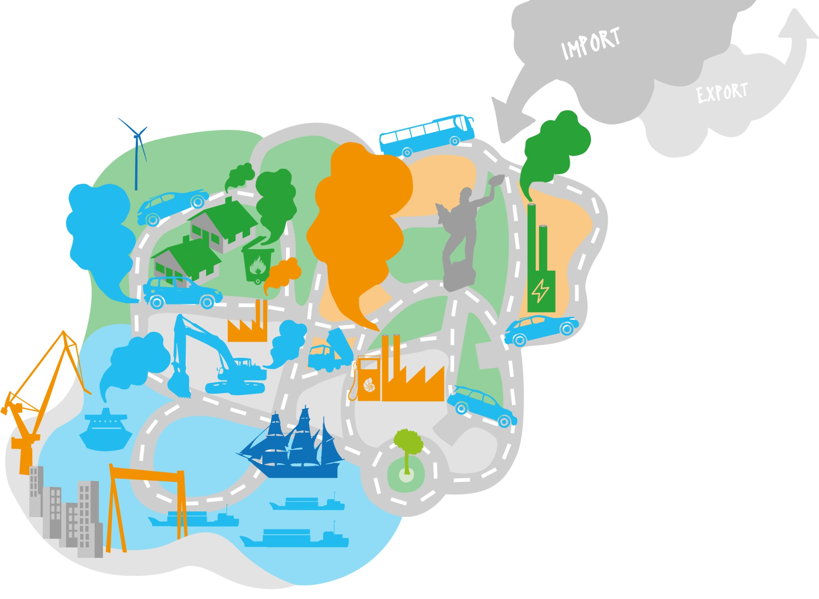
Greenhouse gas emissions in Gothenburg today
Notes:
Today approximately 2,5 billion tonne carbon dioxide equivalent emissions yearly within Gothenburg’s geographical are (production perspective)
Emissions divided mainly in three categories
energy (green clouds)
transport (blue clouds)
industry (orange cloud, refinery largest)
Challenges
Large industry with refineries, heavy transport, large organisation, limited possibilities to ”decide” for private sector, cross-sectorial working problems
Oppurtunities
Responsible for infrastructure, energy, authority, education and community planning.
Large share of municipally owned housing, an energy company partially owned by the municipal organisation, a well-developed district heating system, an efficient waste incineration plant with electricity- and district heating production and our own port. We are also a partner in the local airport.
Good experience of working closely with researchers and industry.
Participating in several networks, locally, regionally, nationally and internationally.

Slide 4
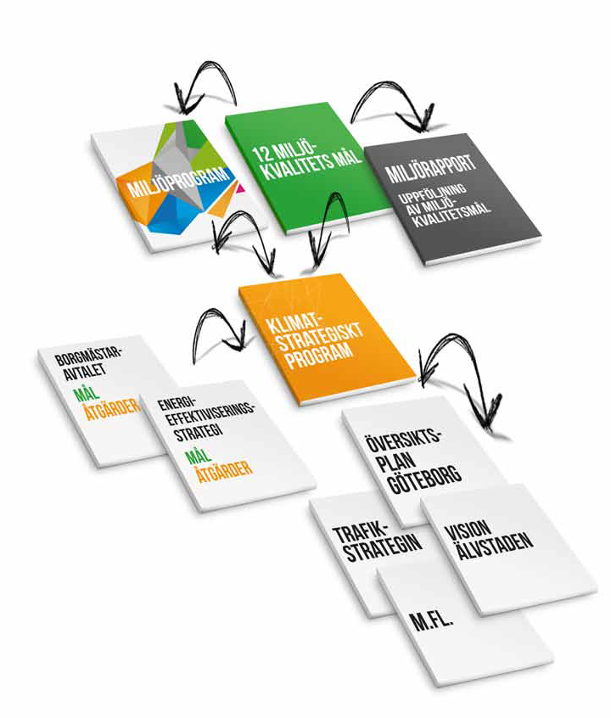
The Climate Program builds on
National environmental goals
Covenant of Mayors agreement
City development plan
Traffic strategy
River City Gothenburg
Etc.
Notes:
Revision of strategies in the Climate Programme every third year and monitoring via the Environmental Report every year.

Slide 5
From vision to action
24 strategies distributed in five areas
The climate-smart citizen
Resource efficient planning
Efficient energy use and conversion to renewables
Reduced climate stress from travel and transport
Climate conscious consumption
Notes:
Our strategies have been selected through collaboration with other stakeholders, internal and external in the city, with the basis of our biggest challenges. Huge difference on how it was developed this time against last.
More stakeholders (internal and external, business, researchers and NGO’s) both during the development and implementation of the Climate Programme
There are two strategies about urban planning which exists to support other strategies. Many of the actions support each other.
Our approach is also to involve officials working with urban planning in efforts to implement the Climate Programme. The Climate Programme is in line with the Comprehensive Plan.
Finished product is more firmly established (anchored) among both politicians and officials.

Slide 6
Greenhouse gas emissions per capita
Aviation 46% (-19%)
Road transports 1,2% (-98%)
Public transports 1,1% (-56%)
Electricity 0,8% (-98%)
Heating 0,1% (-99%)
Food 35% (-56%)
Public consumption
12% (-87%)
Private consumption
4,5% (-94%)
Notes:
Idag släpper den genomsnittliga göteborgaren ut cirka 8 ton växthusgaser per år. Utsläppen sker både här i Göteborg men också i andra länder runt om i världen till följd av vår konsumtion. Gubben på bilden visar fördelningen av utsläppen på olika kategorier.
I offentlig konsumtion räknar vi in det som kommunala, regionala och statliga aktörer köper och använder. Det är alltså det som konsumeras inom till exempel kommunala skolor, äldrevård, sjukvård och kulturverksamhet.
Övrig konsumtion syftar till den privata konsumtionen och här ingår köp av till exempel kläder, skor, möbler, restaurangmåltider, alkohol och tobak, förbrukningsvaror (smink, toapapper etc.), bilar, hemelektronik och upplevelser/nöjen.
Scenariot för 2050 är framräknat av målen i klimatprogrammet och dagens klimatpolitiska inritning. Vi har inte tagit hänsyn till effekter från beteendeförändring eller nya styrmedel mm.
SEAPen är ett verktyg för att nå målet.

Slide 7
Enhanced SEAP
More robust
More flexible to local and global changes
Possible for more stakeholders to involve in future actions
Strategies have been chosen through stakeholder involvement
Strategies are combined through our challenges and objectives
Notes:
It is more robust since it is more firmly established in the organization.
Since we decided to have long term strategies will the Climate Programme be more flexible for both local and global changes.
The objectives are ambitious so it is hard to put specific actions right now since they will not be sufficed to come. This will on the plus side lead to the possibility for more stakeholders to do actions that contribute to the end objective
Our challenges rather concerns what type of energy we should produce, how much money we can get off on investments in renewable energy.

Slide 8
Step Up and the Climate Programme
More resources to stakeholder involvement and development
Updated energy balance
More defined objectives
Prioritising of actions
Helpful to implementation phase
Notes:
It has given us the opportunity to have a greater investment on collaboration and to put more resources into developing the Climate Programme.
An updated energy balance which was very useful.
Thanks to 2.4 became the objectives more defined
Through 2.5 decided we which actions were most valuable for us to incorporate in the Climate Programme.
2.6 have a great potential to be used in ongoing implementation.

Slide 9
Learning points
SEAP template isn’t as flexible as one could want
Valuable to involve many stakeholders – takes time though
Can be a challenge to commit right people
Challenge to find right level for objectives and strategies
Important with well prepared project management
Anchoring among stakeholders both during development and implementation
Well aware politicians
How to fit in Climate Programme to requirements of a SEAP
Nicely packaged
Notes:
What we have learned is that CoM SEAP template is still not as flexible as we would like for each city and not just be a shelf warmer.
It is valuable to involve many stakeholders in the process it gives good quality to the actions and objectives. But it will also take long time with broad collaboration and a solidly based strategic document.
Sometimes is it a challenge to get commitment from other departments/stakeholders, it is hard to find people with the right skills, knowledge and commitment.
A challenge is to find right level for objectives and actions which aloud as many stakeholders as possible will be satisfied and that it is still insufficient to meet the objectives.
Very important to have well prepared project management before starting with your activities.
We can’t emphasize enough how important it is to anchor your work among your stakeholders both during development and afterwards to keep your document alive.
A fundamental piece is to have your politicians well aware with what the process involves.
One of Gothenburgs challenges is to fit in our Climate Programme and meet the requirements of a SEAP.
At last but not at least is it important that your end product is nicely packaged – it makes it easier to read, understand and communicate.

