Slide 1


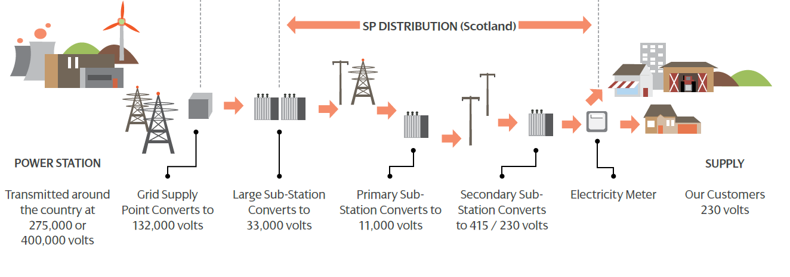
Glasgow Integrated
Energy Planning
www.stepupsmartcities.eu
Distribution Network Operator (DNO)
Scottish Power Energy Networks (SPEN) distributes electricity from the high voltage transmission grid to consumers
1

Slide 2
Glasgow Integrated
Energy Planning
www.stepupsmartcities.eu
IEP development combines electricity distribution network data with Local Authority data, including
  Local Development Plans
  Housing Land Audits
  Commercial, Industrial and Retail Development Summaries
  Vacant and Derelict Land Surveys
Allows the DNO to develop energy demand forecasts based on planned developments rather than past demand trends
Provides the Local Authority with insight into constraints and opportunities impacting local development
2

Slide 3

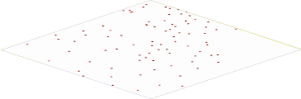
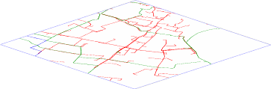

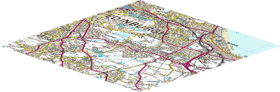
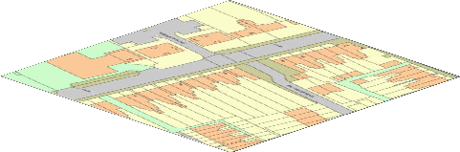
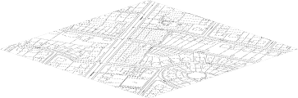
Glasgow Integrated
Energy Planning
www.stepupsmartcities.eu
Proposals & Plans
City Development Data
Substations
ScottishPower Asset Base
Cables / Overhead lines
Aerial Imagery
Landranger
Various Mapping Datasets
MasterMap Topology
LandLine
3

Slide 4
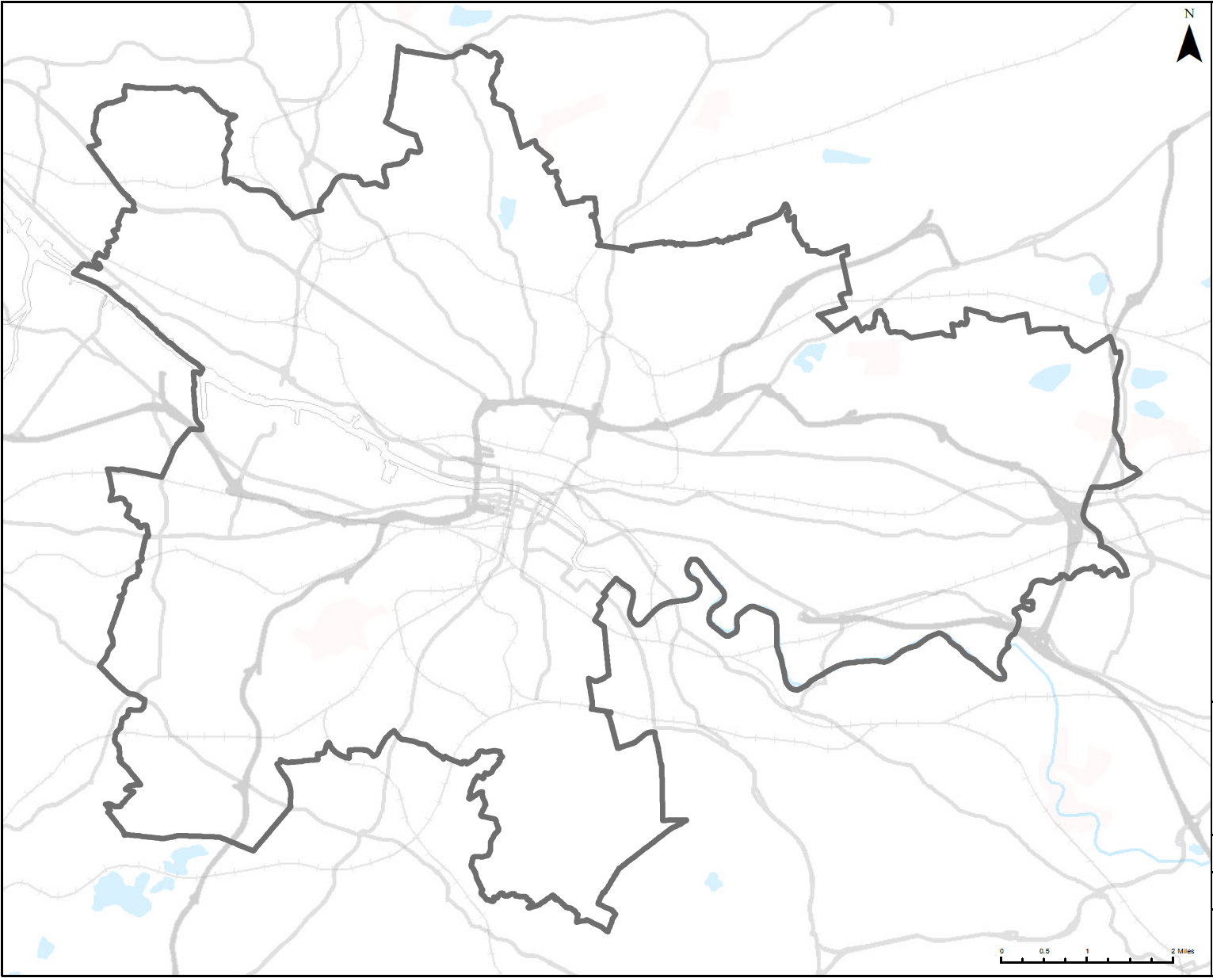
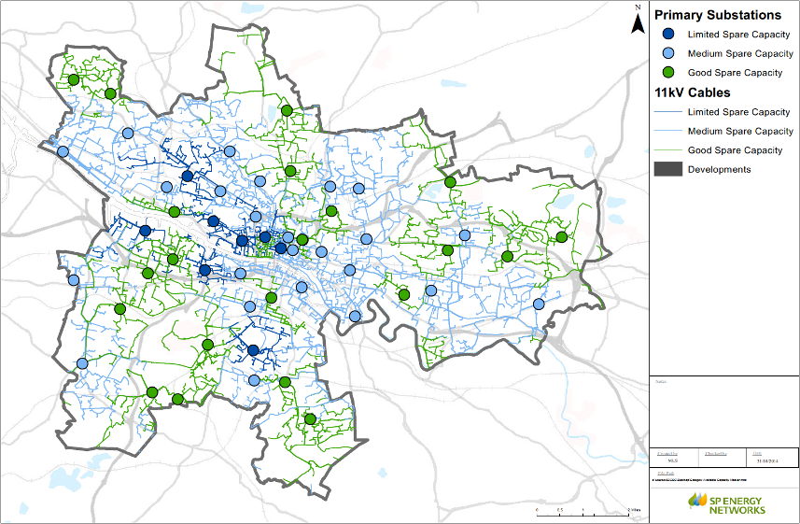
Glasgow - 2013
Available Capacity Map
www.stepupsmartcities.eu

Slide 5
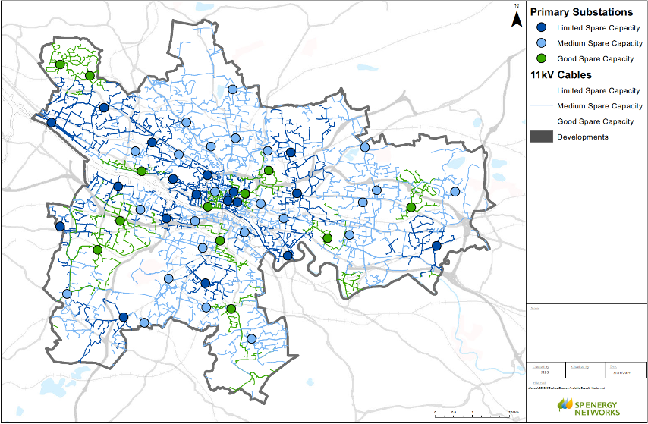
Glasgow
Forecast Capacity 2023
www.stepupsmartcities.eu

Slide 6
IEP Benefits for Glasgow
www.stepupsmartcities.eu
‘Open exchange of relevant policy, planning and development information between ScottishPower and Glasgow City Council.
Allows comparison of ScottishPower investment plans with the City's strategic objectives.
Provides for Energy Investment Planning for energy infrastructure that best supports city economic and social objectives.
ScottishPower will be better able to provide continuing support to key public and private investor developments

Slide 7

Next Steps
www.stepupsmartcities.eu
Political approval for the Energy and Carbon Masterplan (Feb 15)
Complete and submit the SEAP templates
Disseminate/communicate in Glasgow Green Year 2015
Establish ESCo and DH schemes
Input to LDP and Resilience Strategy
Establish City Energy Team
Financing
Monitoring and Reporting
Page 7
Notes:
7

Slide 8

What we have learned
www.stepupsmartcities.eu
The STEP UP process has worked for Glasgow:
  Able to input results of deliverables into enhanced SEAP
  Learned from other cities
  Benefitted from partners SPEN, UoS
Energy and Carbon Masterplan will be owned and implemented by GCC/Sustainable Glasgow Board
Made links to other plans/strategies - sustainable, smart, resilient city
An enhanced SEAP is an ambitious project for any city to undertake
Need to translate our learning into simple steps for other cities benefit
Page 8
Notes:
8

