Slide 1

















STEP UP Riga Conference Thursday 20th November 2014
Glasgow’s enhanced SEAP
www.stepupsmartcities.eu

Slide 2
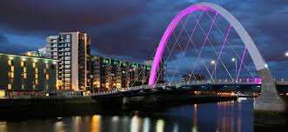
Content
  The challenge
  The vision
  The journey
    From Sustainable Glasgow report to Energy and Carbon Masterplan (enhanced SEAP)
  Integrated Energy Planning
  Next Steps
  What we have learned
Notes:
2

Slide 3
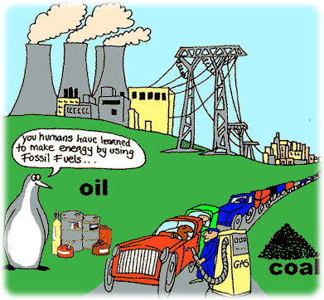

The Energy Challenge
Notes:
Cities need to:
Meet the growing energy needs of rising population
Tackling climate change and reduce greenhouse gas emissions
Become more energy efficient
Become more energy secure
Producing more renewable energy
Continue to thrive economically
Continue to improve the quality of life for residents
Buildings currently account for over 40% of the world energy consumption
Buildings around the world are being transformed with the emergence of ‘passivhaus buildings ’, ‘zero-energy buildings’, and ‘carbon-neutral buildings’.
As buildings are being transformed, cities and local governments will be looking to use more renewables for their heating and cooling purposes
District heating systems will be key to an effective city heating systems using natural gas, biomass, or geothermal energy
Gothenburg, Sweden fulfils 80% of its heating demand from waste incineration
98% of the homes in Copenhagen are connected to the district heating system fired by biomass
Munich already meeting 80% of its heating needs via geothermal sources
3

Slide 4

The vision for Glasgow
Sustainable, Smart and Resilient City
Notes:
A sustainable city will use less resources and produce less waste than a unsustainable city. This concept can be built into the design of cities and buildings
A smart city will make intensive use of ICT to enhance energy efficiency, maximise the integration and use of renewables and ensure smart and sustainable urban transport.
A resilient city reduces vulnerability to extreme events and responds creatively to economic, social and environmental change in order to increase their long-term sustainability.
4

Slide 5


The Journey
Notes:
Sustainable Glasgow launched its report on 27 January 2010 into how the city aims to become one of Europe's most sustainable cities in the next 10 years.
5

Slide 6
Energy and Carbon Masterplan
Action Plan
- Key actions by sector
- Energy savings/sector
- CO2 savings/sector
- Stakeholders
- Costs / timeframe
Baseline Emissions Inventory
-Inventory year 2006
-Emissions factor (IPCC or LCA)
-Emissions reporting units (CO2 or CO2e)
-Energy consumption
-Energy supply
-CO2 emissions
Overall Strategy (ECMP)
30% CO2 target
Monitoring Plan
-Review of strategy
-Monitoring emissions inventory
-Results of emissions inventory
-Review of Key Actions
-Annual monitoring
Vision
Staff capacity
Budget
Financing
Page 6
Notes:
6

Slide 7
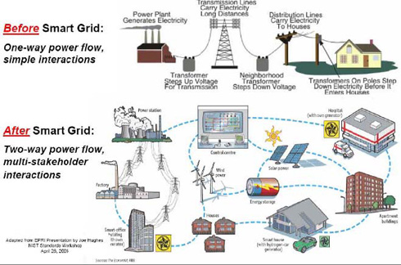
The Overall Strategy
Page 7
Notes:
7

Slide 8
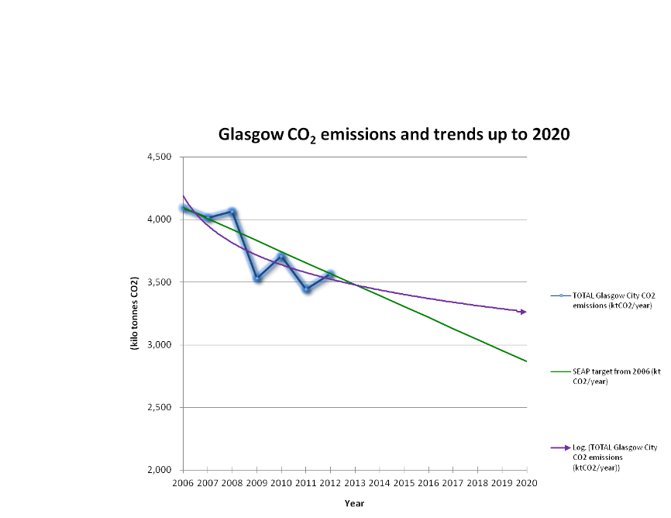
Baseline Emissions Inventory
Page 8
Notes:
8
Glasgow emitted around 4,000 kt of CO₂ in 2006
Glasgow needs to be below 3,000 kt CO₂ by 2020 (need to save 1228 ktCO2 in total)
Glasgow's CO₂ emissions reduced by 13% from 2006 – 2012 (saved 530.7kt CO2)
Trendline shows that we have ‘challenges’ beyond 2013 (still need to save 697 ktCO2)
A new set of actions is required
Using the pattern of the existing city’s carbon emissions up to 2012, a logarithmic trendline for predicting emissions by 2020 is shown. It assumes that city emissions behaviour is kept with the same levels of growth population and economics. If these assumptions are right, the trendline shows that Glasgow would meet up the SEAP target up to 2013; from that year onwards the emissions will continue rising, opening a gap with SEAP targets.
SEAP Target (reduction 30% CO2) was achieved by Glasgow City for 2007, 2009, 2010, 2011; and was not achieved in 2008.

Slide 9
Glasgow Energy Summary
www.stepupsmartcities.eu
Glasgow consumes approximately 12,500 GWh of energy per annum

Slide 10
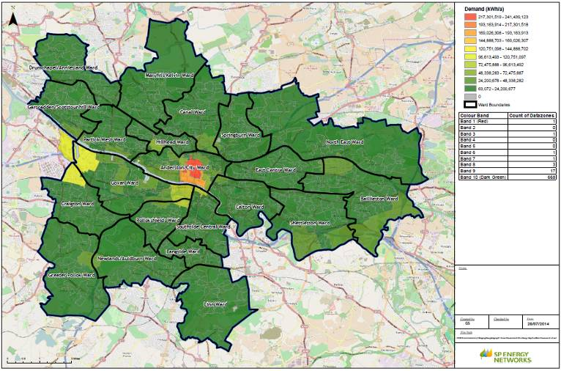
Glasgow Building Energy Consumption
www.stepupsmartcities.eu
Glasgow consumes approximately 12,500 GWh of energy per annum

Slide 11
Action Plan – meeting the target
Page 11
Notes:
11

Slide 12
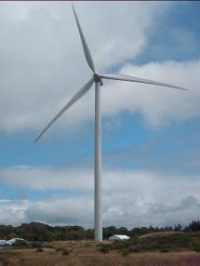
The Action Plan
  Maintain same overall Vision as 2010 report
  Retain 30% CO₂ savings by 2020 target
  Key challenge: reducing electricity consumption for heating
  33 actions featuring:
    Development of ESCo and district heating schemes
    Phasing out coal, oil and electric heating
    Improved energy efficiency and building energy management
    New LED street lighting
    New Waste to Energy plant by 2016
    Promotion of electric vehicles and active travel
    New wind turbines and solar PV
    Behavioural change and DSM
    Integrated Energy Planning
Page 12
Notes:
12

Slide 13
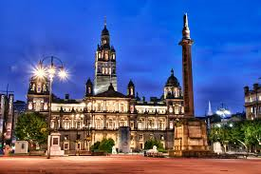
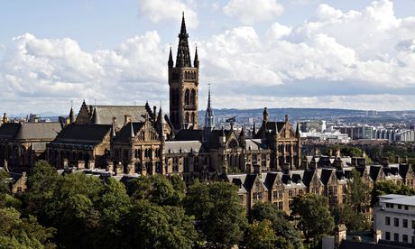
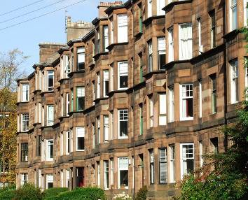
Buildings (Municipal, Tertiary and Residential)
Page 13
Notes:
13
Municipal Buildings
Carbon Management Plan aligns to 30% reduction target by 2020
74% carbon emissions from buildings, 18% street lighting, 8% transport
Actions: BMS and retrofitting buildings, PC shutdown, voltage & boiler optimisation, electric vehicles, LED lighting
Tertiary Buildings
Use SPEN heat mapping and FCD energy model to target private sector energy consumers we need to work with
Residential Buildings
Energy efficiency & insulation retrofit in social housing, G-HEAT team
Tackle retrofitting in private housing (tenements)

Slide 14
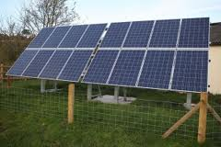
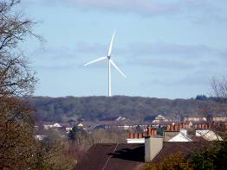
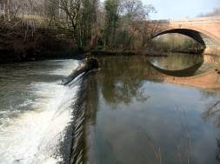

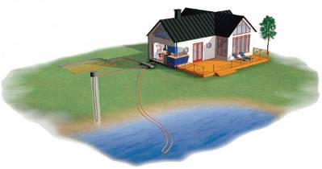
Local Electricity Production, Local Heat/Cold Production
Page 14
Notes:
14
Local electricity production
Wind turbines
Solar photo-voltaics on vacant land
Energy from waste
Potential for geothermal, heat pumps and
Micro-HEP
District Heating
North Glasgow/City Centre North
Polmadie/Gorbals
Athletes Village
Energy Services Company (ESCo)
Smart Grids
Intelligent technology and smart meters
Demand Side Management

Slide 15
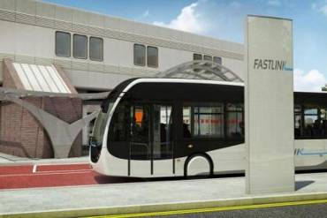
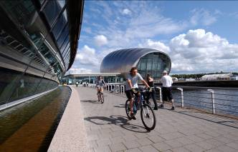
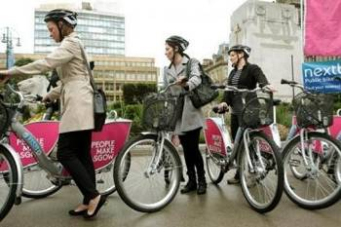
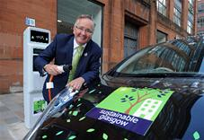
Transport
Page 15
Notes:
15
Municipal Fleet
Reduction in numbers, journeys, route rationalisation, procuring most efficient vehicles
Driver education
Electric fleet vehicles
Private and commercial
Free electric vehicle charging points
City bike hire scheme
Bus operators – electric vehicles
Sustainable Transport
Local Transport Strategy
Active travel – cycling, walking
Improvement to public transport

Slide 16

Waste
Page 16
Notes:
16
Waste hierarchy
Using waste hierarchy in strategic waste management
Waste Strategy 2010
Aligns with Scottish Government Zero Waste Plan
Covers –
Collection
Recycling
Residual Waste Treatment
Landfill
Glasgow Recycling and Renewable Energy Centre will
Divert 90% of green bin residual waste away from landfill
Releasing recyclable resources
Produces heat and power

