Slide 1


Workshop – Local Financing, Role of ESCo
Gavin Slater
City Energy & Carbon Manager, Glasgow City Council
www.stepupsmartcities.eu
Notes:
1

Slide 2
District Heating Delivery Structures
Option | Description | Risk allocation | Example
1 | Entirely public sector funded, operated and owned | Public sector retains all risk | Purchase contracts for equipment only
2 | Public sector led, use of private sector contractors | Private sector assumes construction and possibly operation risk | Purchase turnkey asset delivery contract, possibly with maintenance and/or operation
3 | Private sector invests/takes risk in some elements of the proposed activity | Private sector takes risks for discrete elements | As 2 with increased private sector operational risk, and payment or investment at risk
4 | Joint venture, equal share in project with a private sector partner | Most risks are shared | Joint Venture – both parties investing and taking risk
5 | Public funding to incentivise private sector activity | Public sector support only to economically unviable elements | Power Purchase Agreement
6 | Private sector ownership with public sector promise in element of the project | Public sector underpins key risks | Public sector guarantees demand or credit risk
7 | Private sector ownership with only involvement from public sector in facilitation role | Private sector risk beyond early stages development | Public sector makes suitable site available and grants lease/licence/royalty arrangement
8 | Total private sector owner project | Private sector carries all risks | No or minimal public sector role
Page 2
Notes:
2

Slide 3
ESCo Ownership Models
Delivery Structure | Description | Example
Wholly owned public sector | Public sector organisation leads the development of the project and takes full financial risk. Elements of the construction and operation are outsourced through turnkey asset delivery contracts. | Aberdeen Heat and Power Dunfermline Islington / Bunhill
Wholly owned private sector | Private sector led development with private sector entity taking full financial risk for the project. | Birmingham Leicester Kings Cross
Housing scheme | Residential Social Landlord led project, with RSL taking financial risk for the project. Elements of the construction and operation are outsourced through turnkey asset delivery contracts. | Cube Housing Association
Page 3
Notes:
3

Slide 4

Key Considerations
  What influences the delivery structure?
  Stakeholder drivers & objectives
  Desire for control
  Appetite for risk
  In-house capacity and capability
  Commercial viability
  Access to capital / finance
  New build or retrofit
  Scale & project phasing
  Legislation & regulation
  Exit strategy
Page 4
Notes:
4

Slide 5
Perceived Risk
Risk
Control
Perceived risk often greater than actual
Appropriate risk allocation is key
Potential to manage through contracts and performance tools
What is appropriate level of control?
Applicable to all assets?
Does control require ownership?
Page 5
Notes:
5

Slide 6

Financing Considerations
  Delivery structure must be developed alongside funding strategy
  Significant upfront capital investment to develop heat networks
  Limited public sector capital & competing priorities
  May need to attract external finance (public or private)
  Main asset (pipework) has a long useful economic life (40+ years)
  Difficult to finance network without long-term heat supply agreements
  Unregulated market can make revenue streams difficult to guarantee
  Project returns are often marginal, with conflict between meeting the strategic aims of a project and creating a commercial market offering
  Project development / transaction costs high relative to size of project
  Consider bundling smaller schemes to spread risk and reduce overall cost of capital
Page 6
Notes:
6

Slide 7
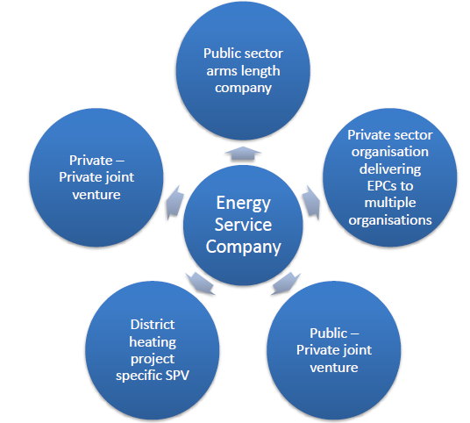
The Role of the ESCo
  An ESCO is JAA!
  Public sector arm’s-length vehicle
  Private sector EnPC concessionaire
  Project specific special purpose vehicle
  Joint venture (public-public / public-private)
  Form follows function
  Consider advantages – focus, risk transfer(?)
  And disadvantages – administration, cost, tax
  Governance arrangements are critical
Page 7
Notes:
7

Slide 8
Meeting Public Sector Objectives
Option | Description | Ability to meet public sector objectives | Requirement for public funding
1 | Entirely public sector funded, operated and owned | High | Yes
2 | Public sector led, use of private sector contractors | High | Yes
3 | Private sector invests/takes risk in some elements of the proposed activity | Medium-high | Yes
4 | Joint venture, equal share in project with a private sector partner | Medium | Yes
5 | Public funding to incentivise private sector activity | Medium | Yes
6 | Private sector ownership with public sector promise in element of the project | Medium-low | No
7 | Private sector ownership with only involvement from public sector in facilitation role | Low | No
8 | Total private sector owner project | Low | No
Page 8
Notes:
8

Slide 9


Future Trends
  What will influence the direction of travel?
  Continuing scarcity of public sector capital
  Increased public sector capacity to deliver
  Increased connection of public sector assets
  Increased public-to-public collaboration
  Strategic approach: over-sizing / future proofing and bundling of schemes
  Regulation – e.g. planning policy, renewable incentive schemes, power purchase
  Increasing use of energy service companies
  Longer term: separate ownership & control of generation, transmission & distribution assets
Page 9
Notes:
9

Slide 10
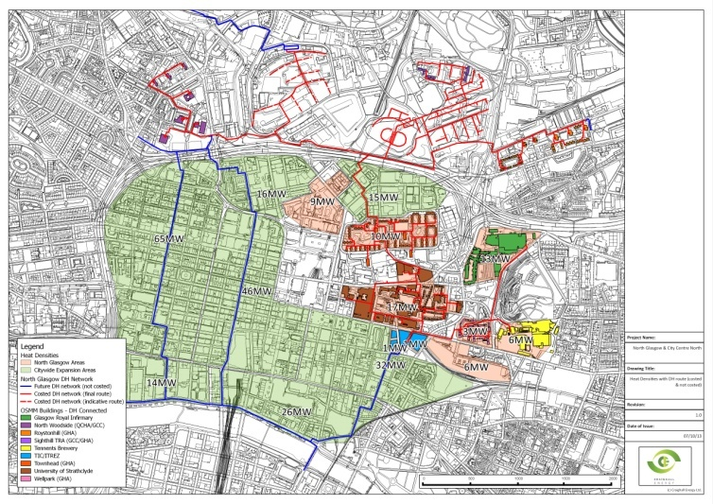
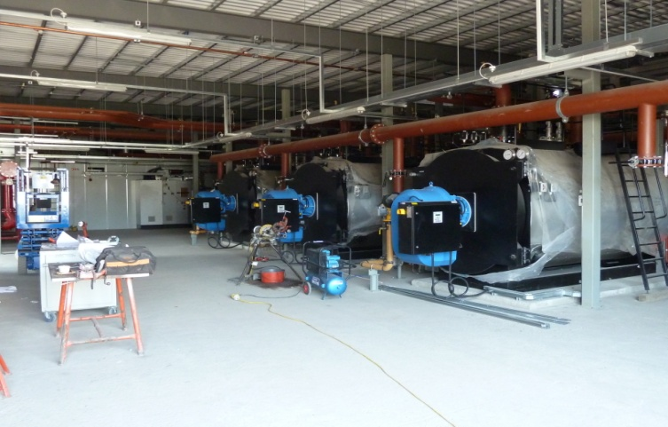
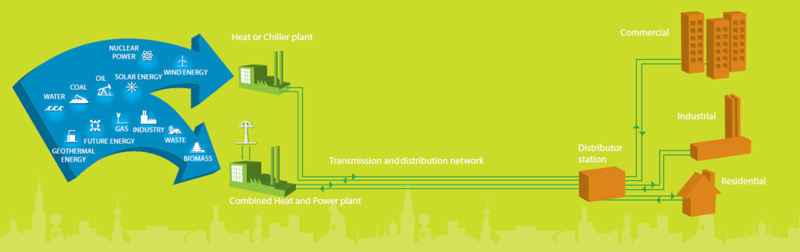
Position in Glasgow
  Developing the ESCo
  Strategic Business Case agreed
  ITT for legal, financial, and technical support issued
  Appointment of Consultants in Jan 15
  Completion of final business case June 15
  ESCo begins operating July 15 with ‘The Village’
Page 10
Notes:
10

